Slide 1

Dynamics 365 F&O Upgrade Tech Talk: Code
Code, Customizations, Extension and Power Platform (AX 2012 Upgrade Series: Part 5)

Slide 2
Synopsis
We’ll discuss how to upgrade your code from AX 2012 to Dynamics 365 F&O. We’ll cover the upgrade process inside LCS, the changes for code in Dynamics 365 F&O and the extension model, how to manage your code in Azure DevOps plus integration opportunities that may make moving customizations to the power platform advantageous.​
PowerPoint available for download at https://github.com/NathanClouseAX/CommunityPresentations/tree/master/2021

Slide 3
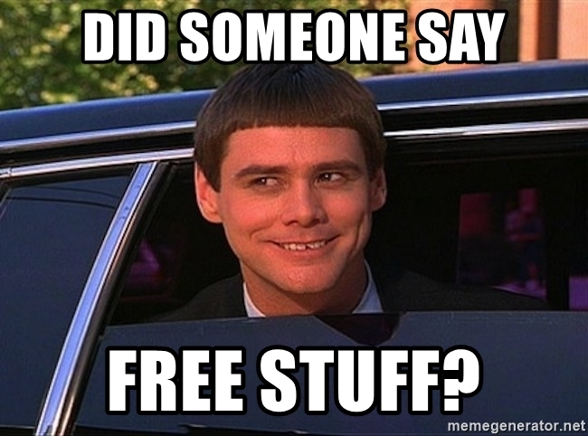
Free Stuff
Gift Card Give Away!

Slide 4

Nathan Clouse
Technical Architect enVista Corp.
Microsoft Business Applications MVP
nclouse@envistacorp.com
www.atomicax.com
@NathanClouseAX

Slide 5

Sukrut Parab
Senior Architect Hitachi Solutions.
Microsoft Business Applications MVP
sparab@hitachisolutions.com
Sukrut Parab - Microsoft Dynamics Community
@SukrutParab

Slide 6
Topics
Upgrade Process
Prerequisites and considerations
Upgrade analysis
LCS Importance
Code upgrade service in LCS
Code upgrade process
upgrade considerations
Code upgrade – reports
Extension Development
Extension request with MS
Azure Dev Ops
Manage code in Azure dev ops
Integration opportunities
Power platform
Notes:
SP: Intro to Upgrading Code
NC: from Upgrading code to end

Slide 7

Upgrades – Why do I need this?
Your system is nearing the end of Microsoft support!
AX 2009
AX 2012
Mainstream support ended October 9, 2018
Extended support ends – April 12, 2022
AX 2012 RTM & R2 – Mainstream support ended Oct 9, 2018
AX 2012 RTM & R2 – Extended support ends April 12, 2022
AX 2012 R3 – Mainstream support ends October 12, 2021 (2 DAYS AGO)
AX 2012 R3 – Extended support ends January 10, 2023
End of mainstream support for Microsoft Dynamics AX 2009, Dynamics AX 2012, and Dynamics AX 2012 R2 - Finance & Operations | Dynamics 365 | Microsoft Docs

Slide 8
Overview – Upgrade process
Upgrade paths
Upgrade from AX 2012 R2 and R3 to 10.x
Code and Data Upgrade
Managed through LCS
Code upgrade estimation and execution

Slide 9
Prerequisites
Upgrade is done through LCS
LCS project is must to start with
Azure DevOps project created to manage process
Connect LCS project to azure dev ops Instance

Slide 10
Key considerations
What to do with ISV Code, Should that be part of upgrade ?
Upside and downside of including ISV model in upgrade process
Get the appropriate version of ISV code
Consider removing unnecessary models from your Model store
Make sure model store you upload is fully compiled

Slide 11
Code upgrade- Analyze
Sign up for LCS
Identify gaps
Create project plan
Select Upgrade methodology
Run upgrade analysis
Run code upgrade tool
Tool : Upgrade process is managed through LCS
Upgrade from AX 2012 R2 and R3 is supported

Slide 12
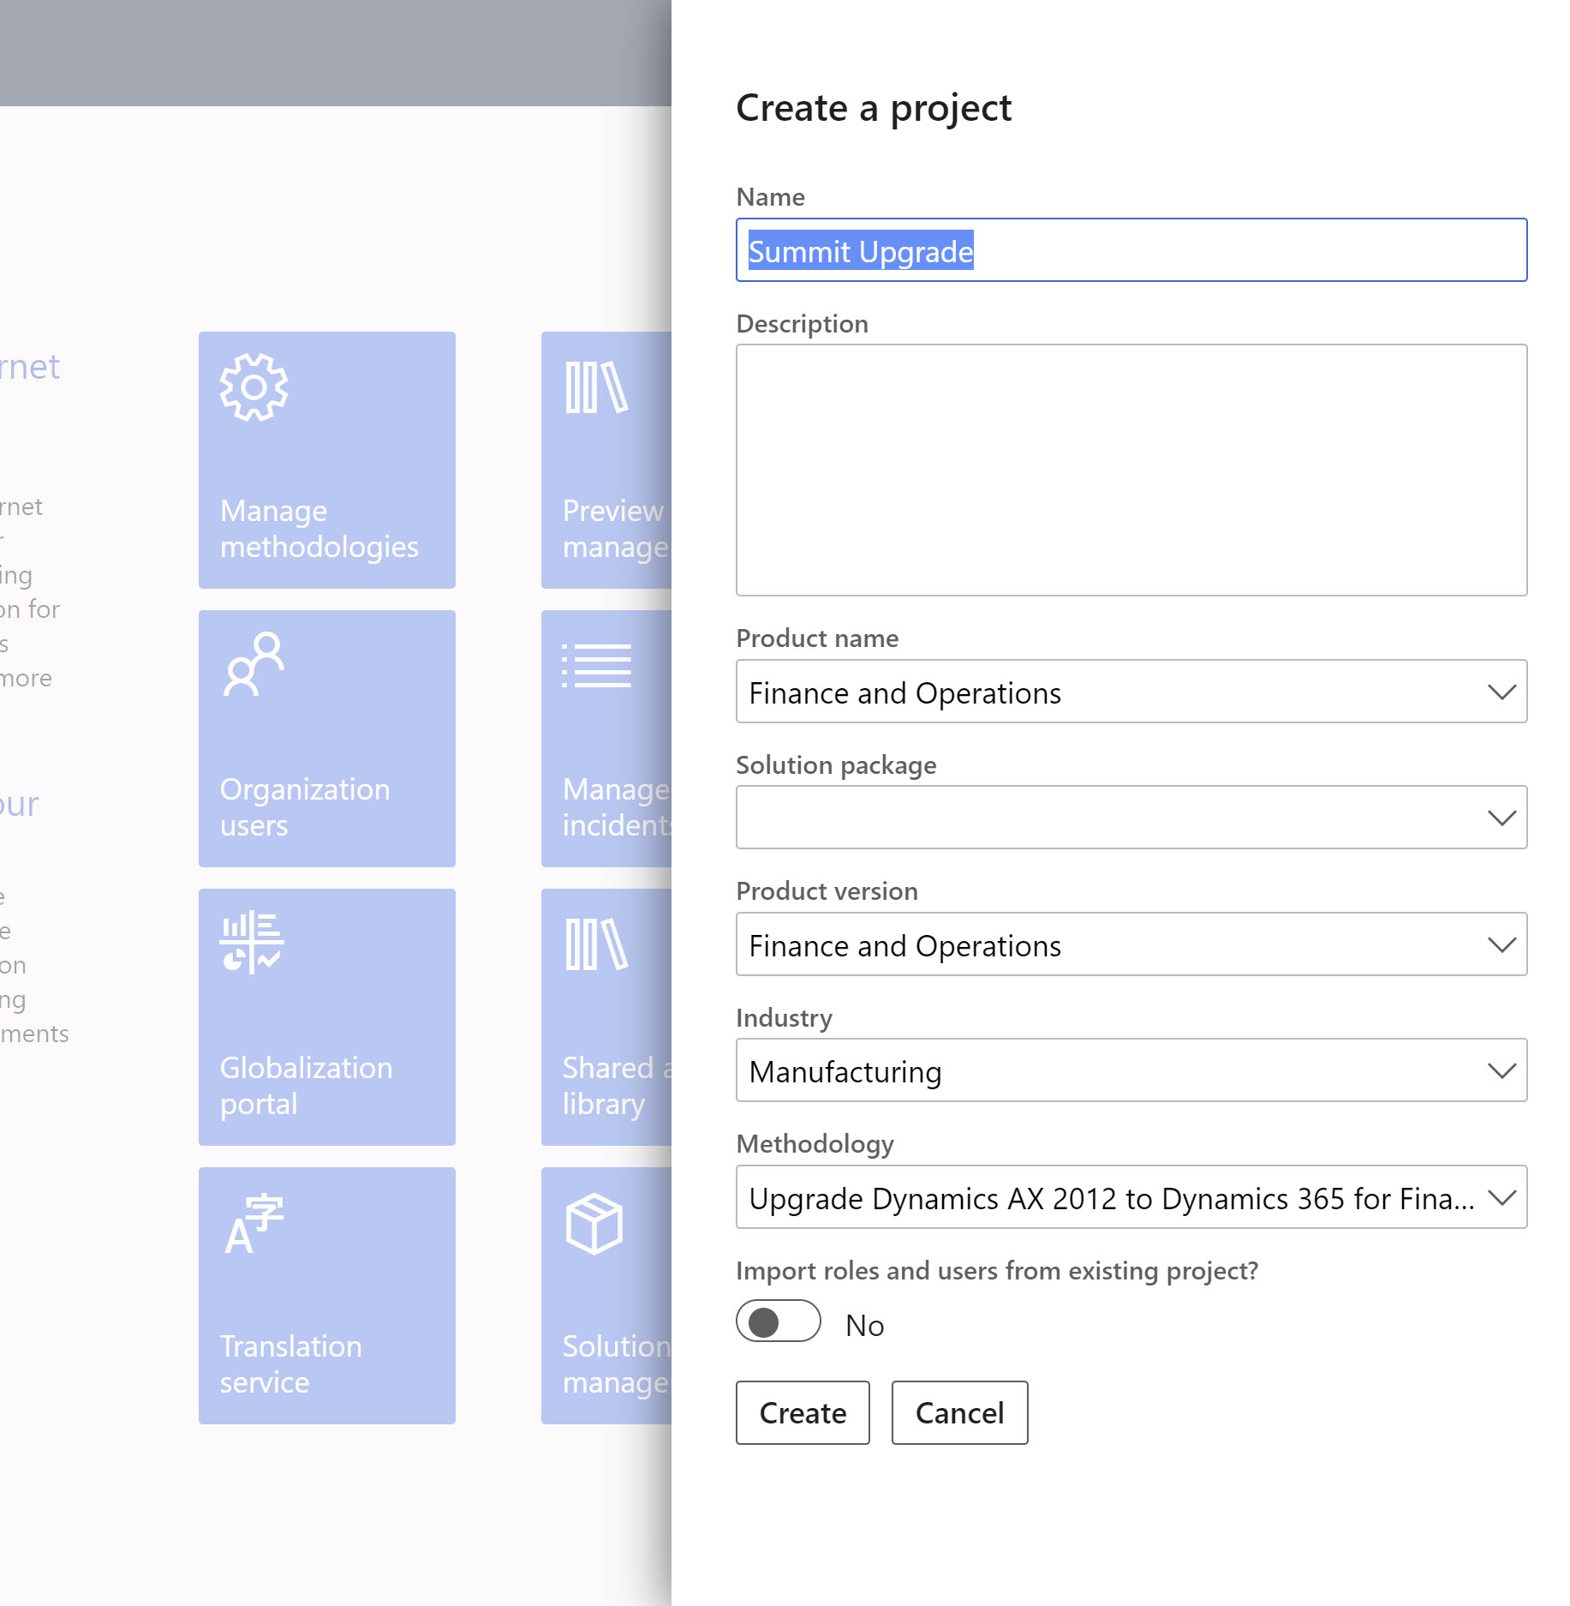
Code Upgrade- Analysis
Project Methodology
Create Project in LCS
Select upgrade AX 2012 to Dynamics 365 methodology

Slide 13
Code Upgrade- Analysis
Run Upgrade Analyzer
Run against Ax 2012 pre-prod environment
Identifies data that you should clean up in AX 2012
Suggests SQL configuration optimizations that can help speed up the upgrade processes
Identifies potential maintenance activities and deprecated features
Results can be viewed from the System diagnostic service in a Microsoft Power BI report in LCS

Slide 14
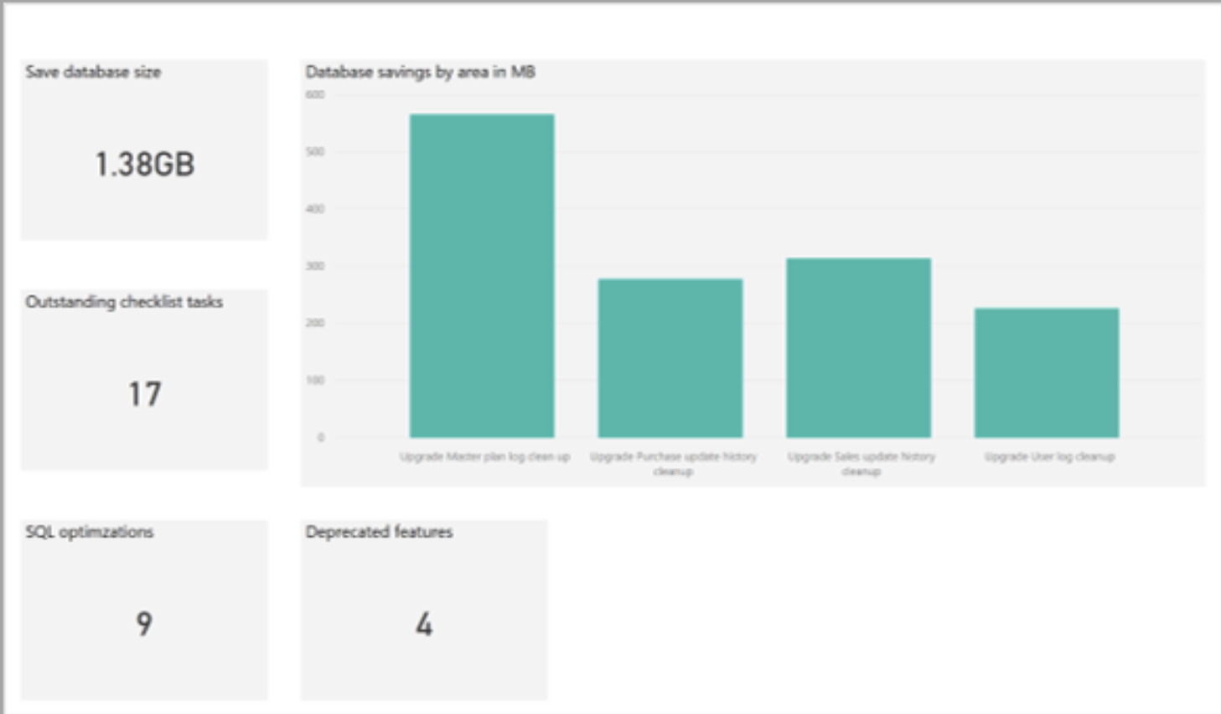
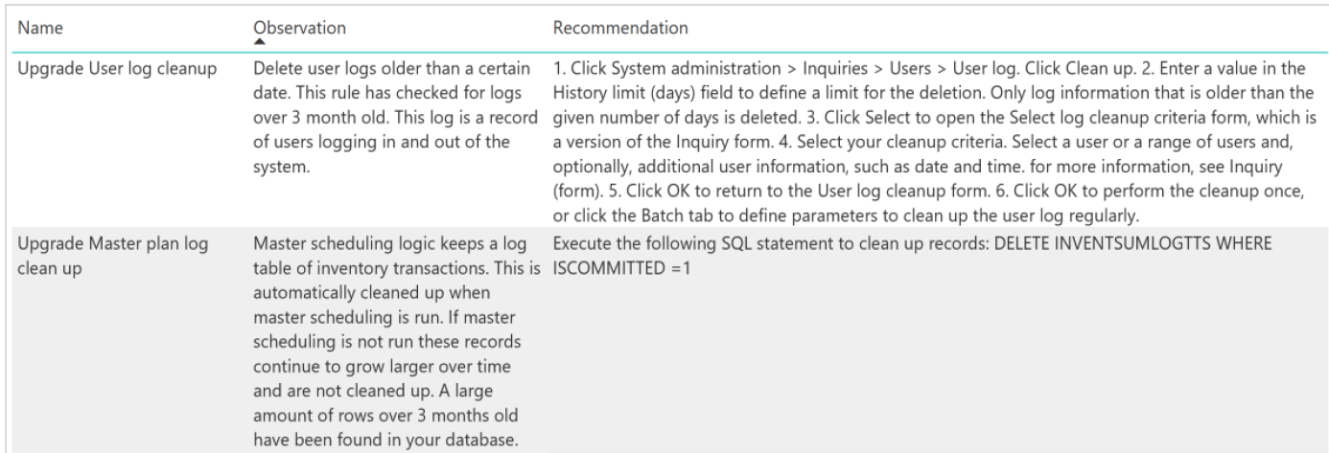
Code Upgrade- Analysis
Report

Slide 15
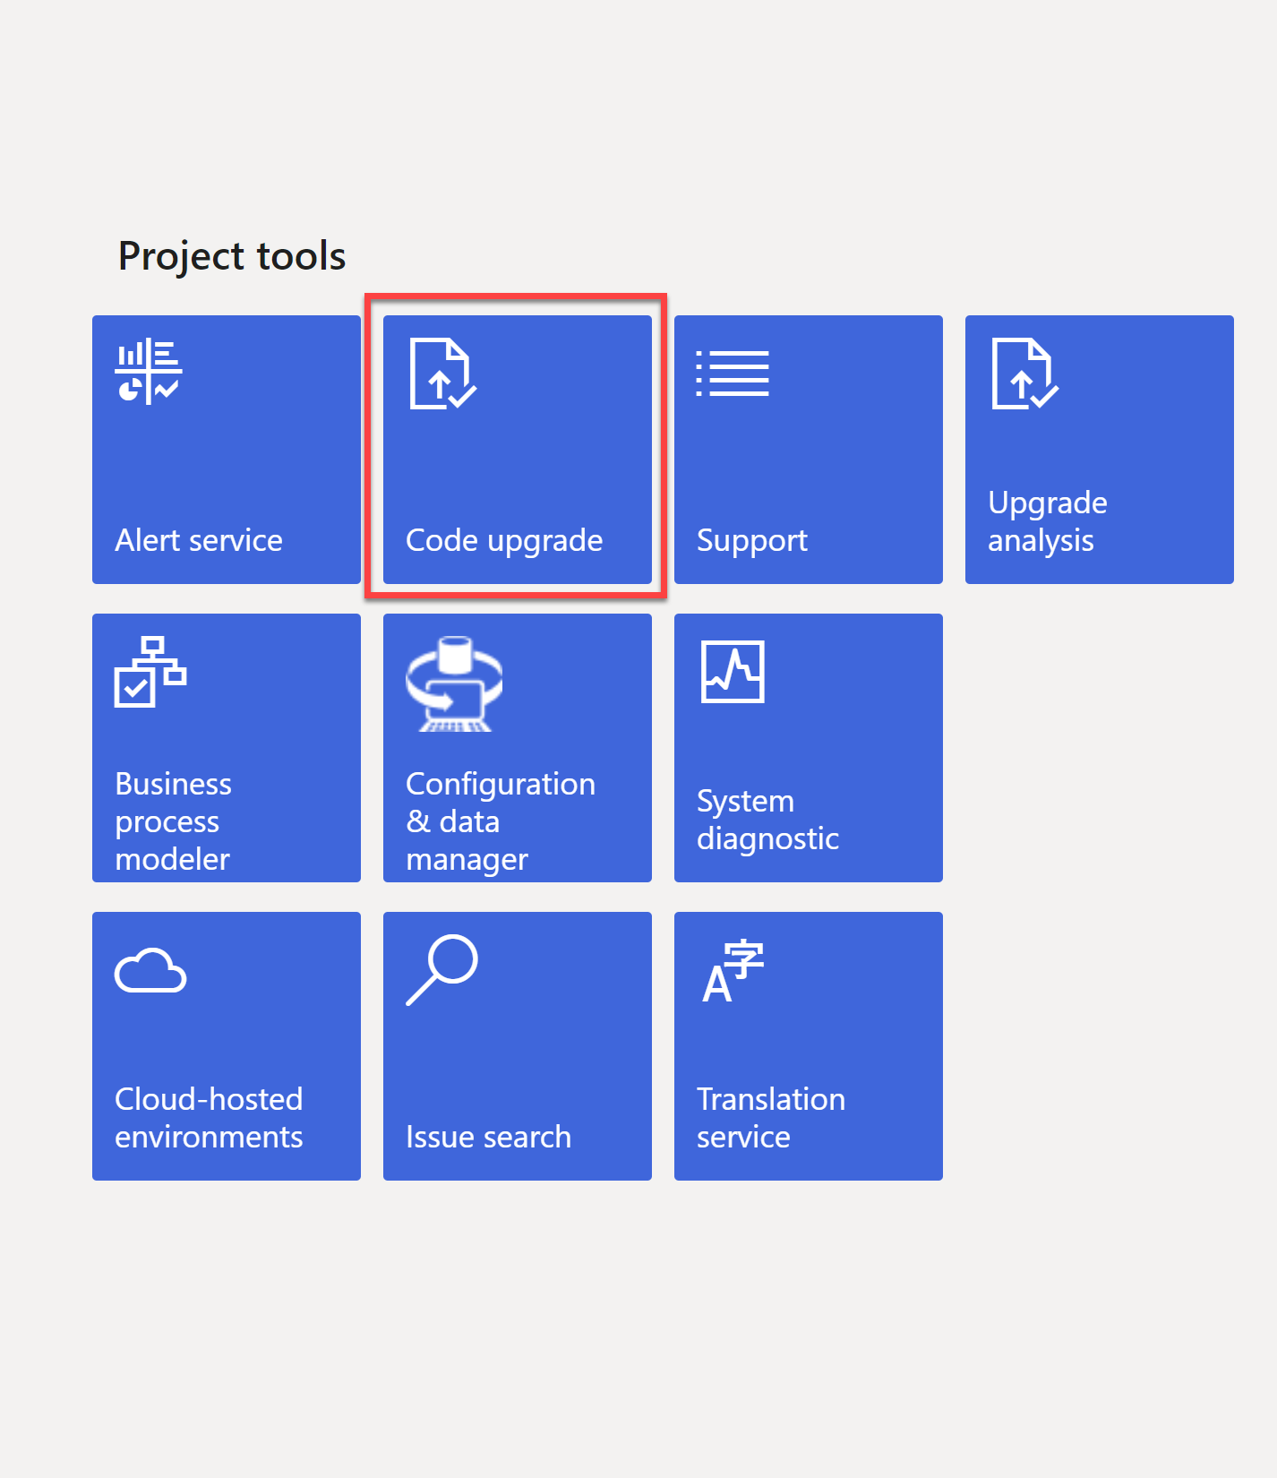
Code Upgrade-Analysis
Run code upgrade service in LCS
Code upgrade service tile in LCS
Upgrades code to finance and operations apps
Code is checked in as overlayered code
Service takes care of most of the over layering related issues
Upgrade efforts can be estimated

Slide 16
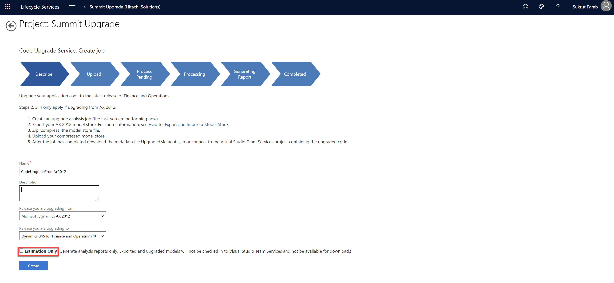
Code Upgrade- Analysis
Create a job in the code upgrade service
For estimation enable “estimation only” check box

Slide 17
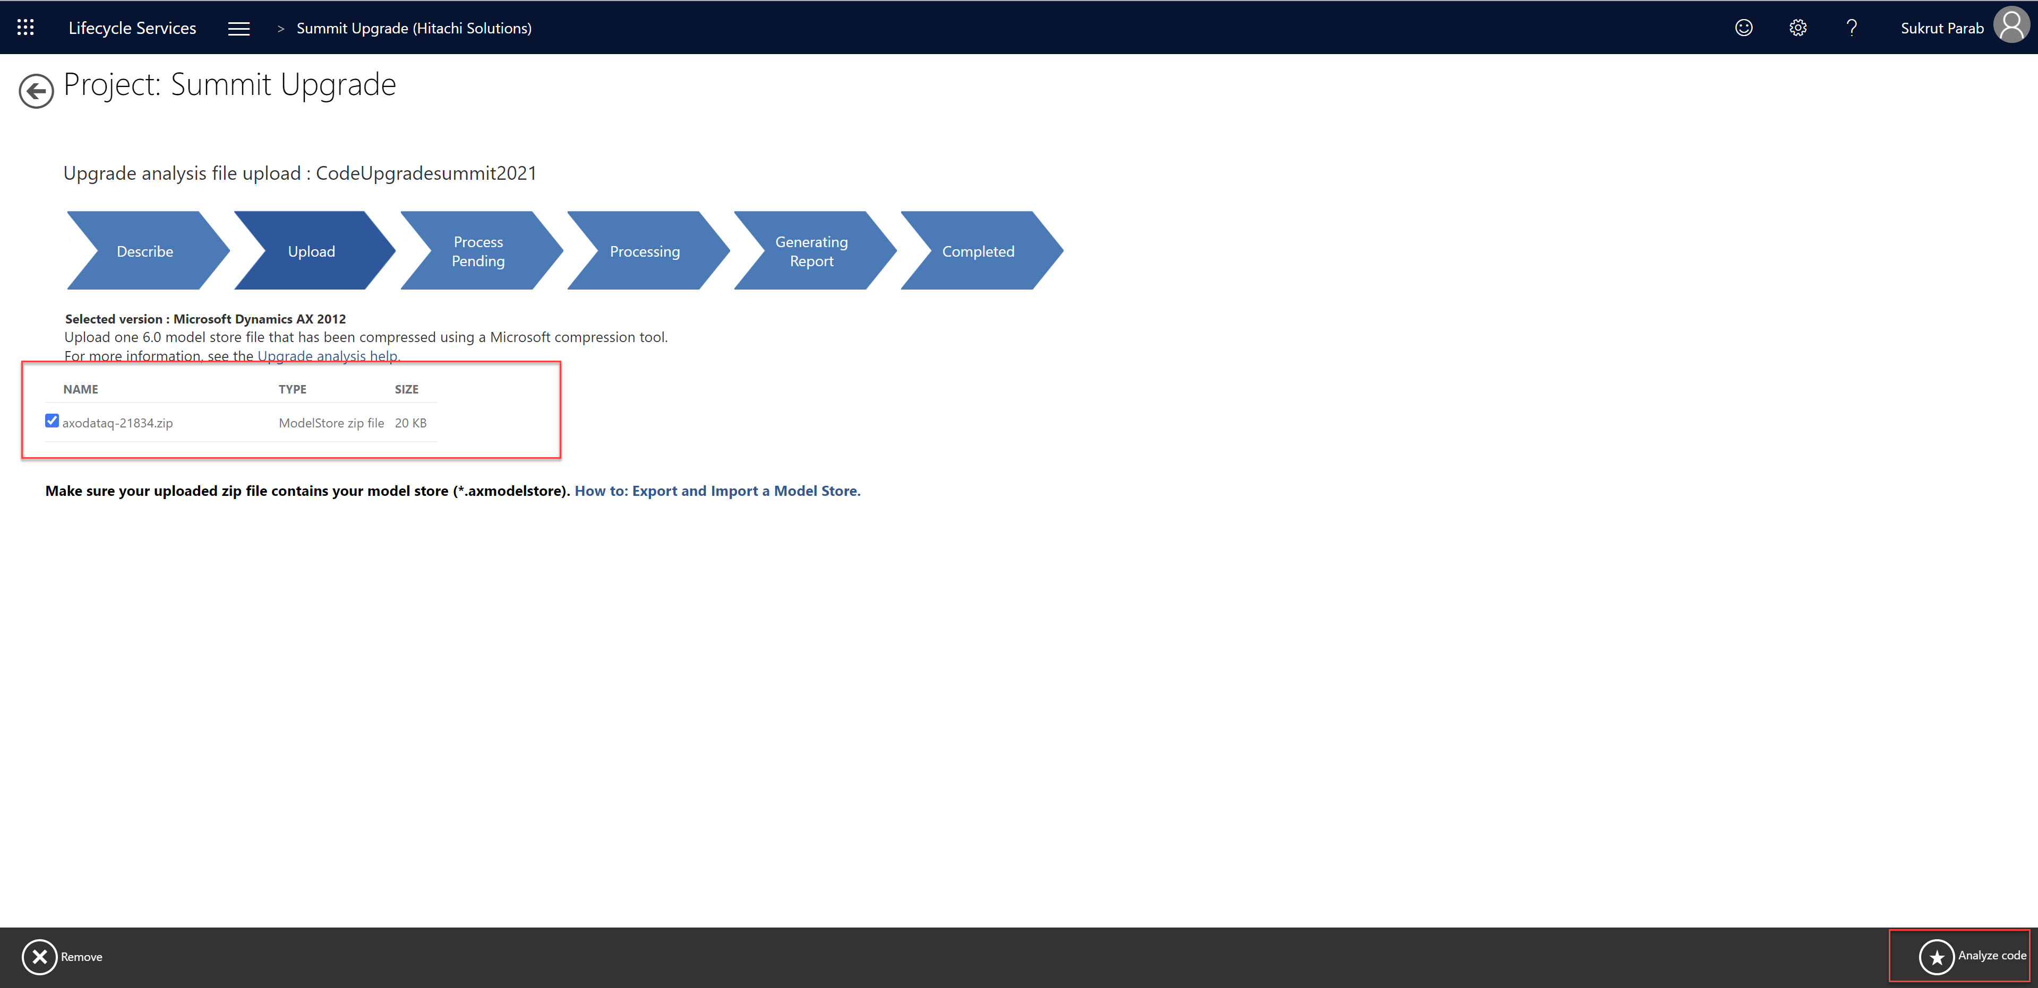
Code Upgrade- Analysis
Select zip file containing model store file
Start code analysis
Review the report

Slide 18
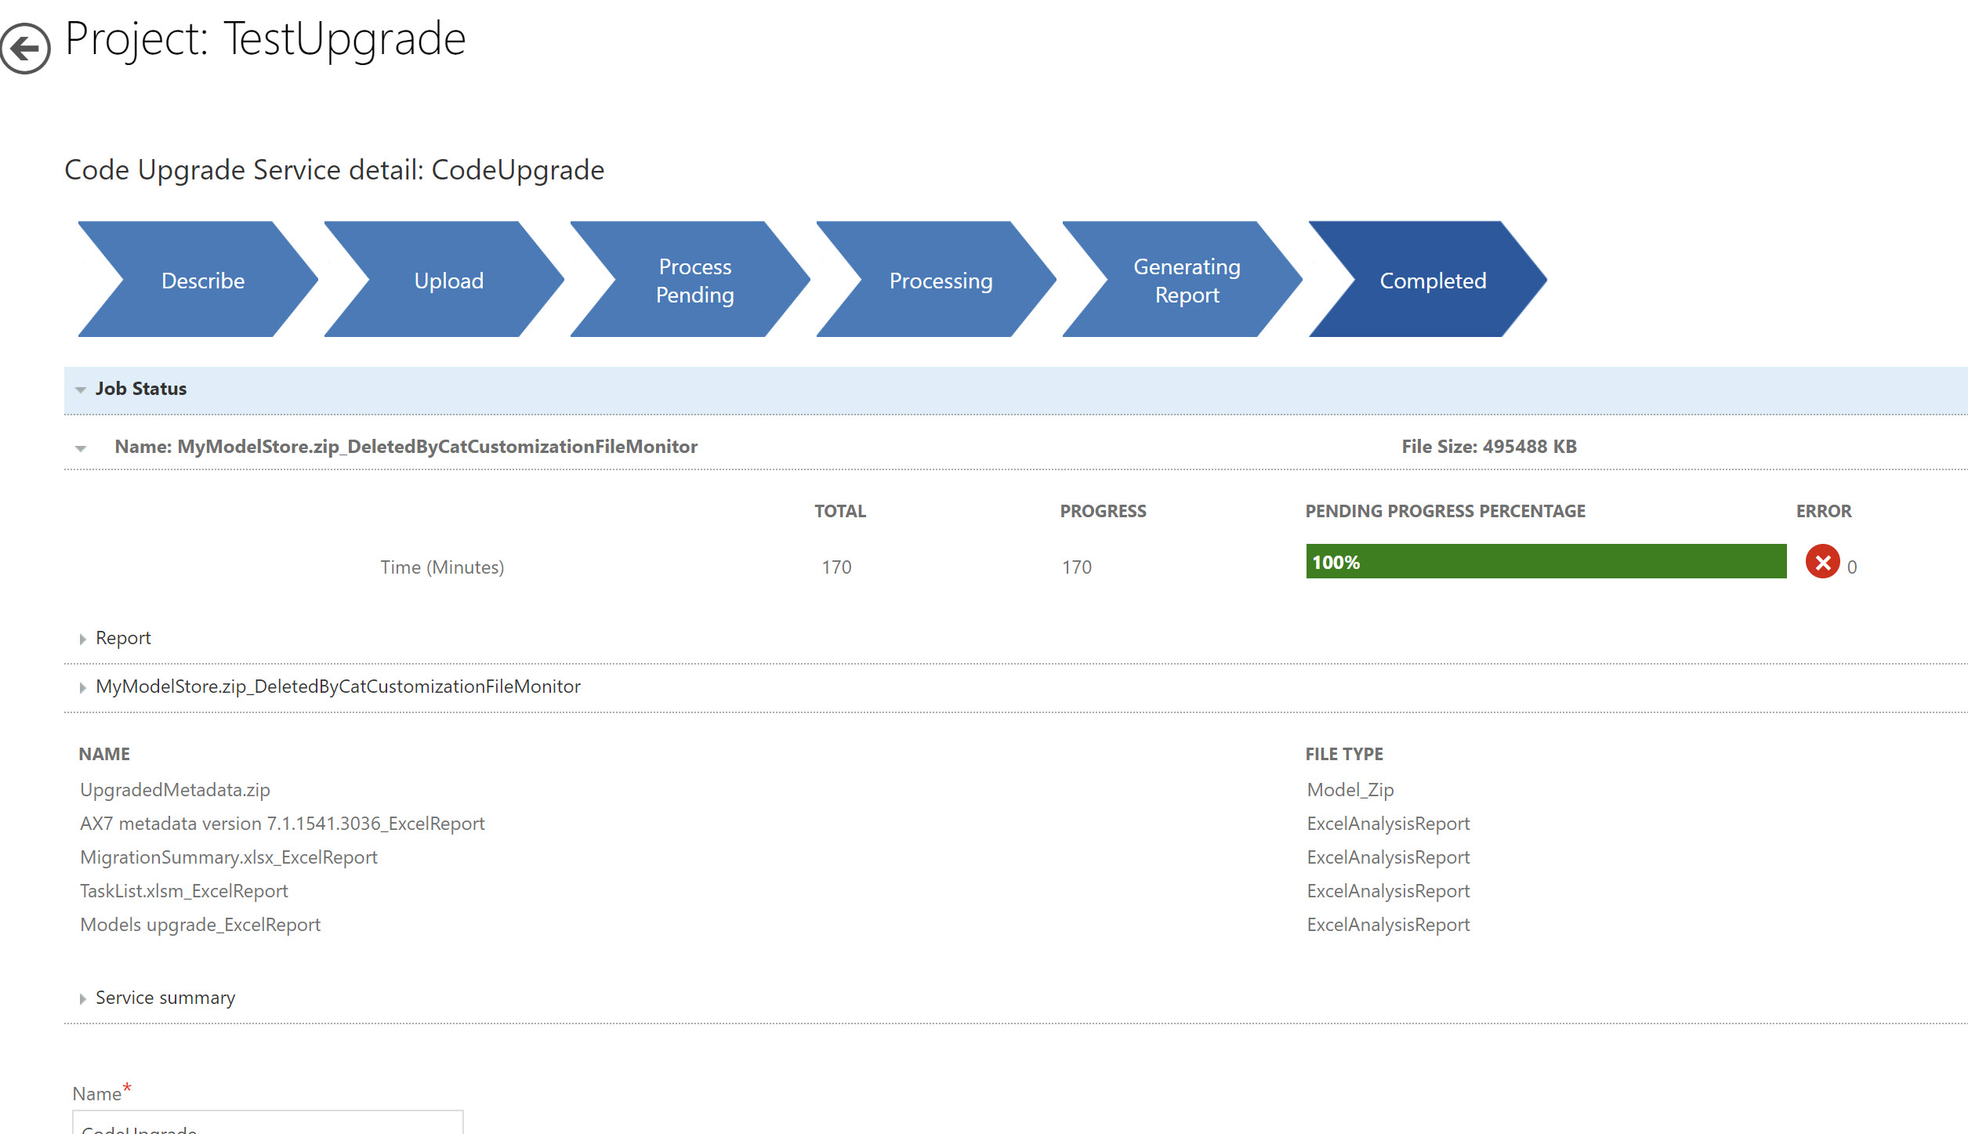
Code Upgrade- Analysis

Slide 19
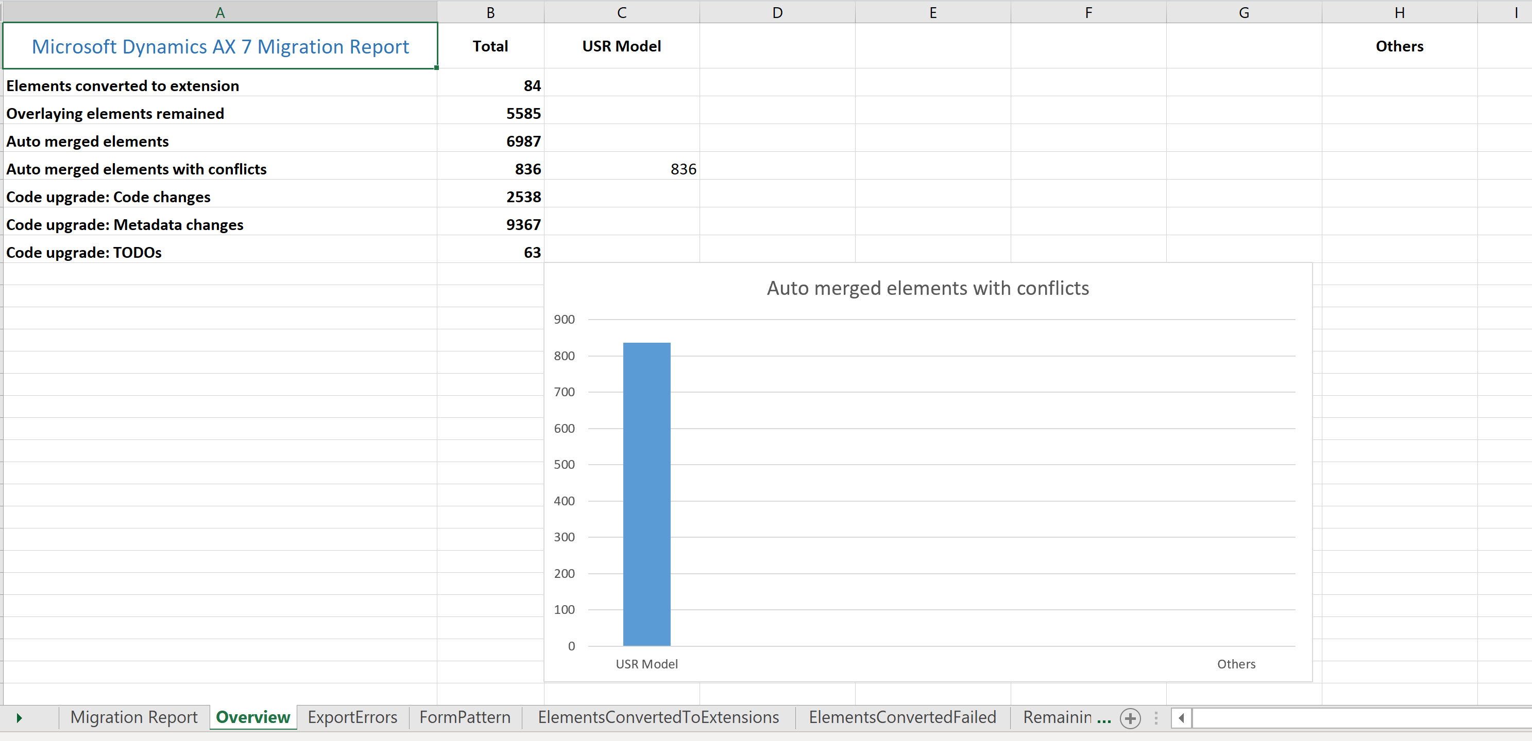
Code Upgrade- Analysis
Summary Report

Slide 20
Code Upgrade- Analysis
Upgraded Code is checked into source control (DevOps)
All upgraded code is overlayered
Work items are created in azure dev ops

Slide 21
Code Upgrade- Analysis
Customization categories
Small – Extension is possible.
Medium – Can be converted to extensions; traversal is required, if needed. You might need to create an extension request.
Large – All report elements are defined as large.
Not in scope – Extension is not possible; traversal is required.
TBD – Unidentified; you will need to define the bucket size.

Slide 22
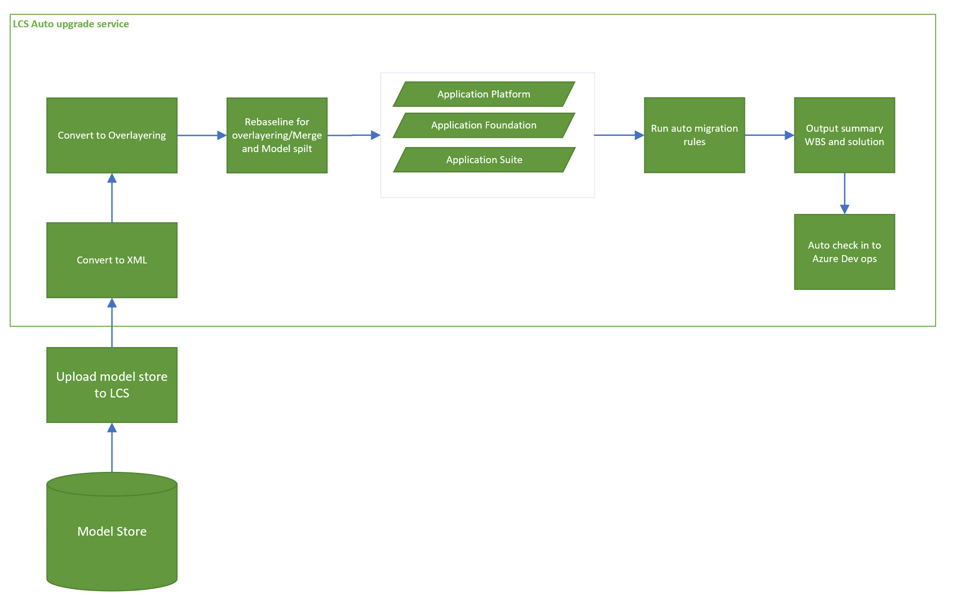
Code Upgrade- Analysis
What happens when we run LCS Service

Slide 23
Code Upgrade- Execution
Create proper branching in Azure dev ops(Dev/Main/Release)
Draft document which has naming conventions, coding standard etc.
Refactor over layering to extensions
Start with lower model (Platform then foundation)and move upwards
Divide tasks within multiple developers
Don’t panic by looking at compile errors
Start with EDT , Enums , tables, views and then move to other objects.
Reports are not upgraded and must be upgraded manually or create extensions.
Complete all task created by upgrade service.
Refactor deprecated features(Integrations designed using AIF, File based integrations etc.)

Slide 24
Extensions

Slide 25
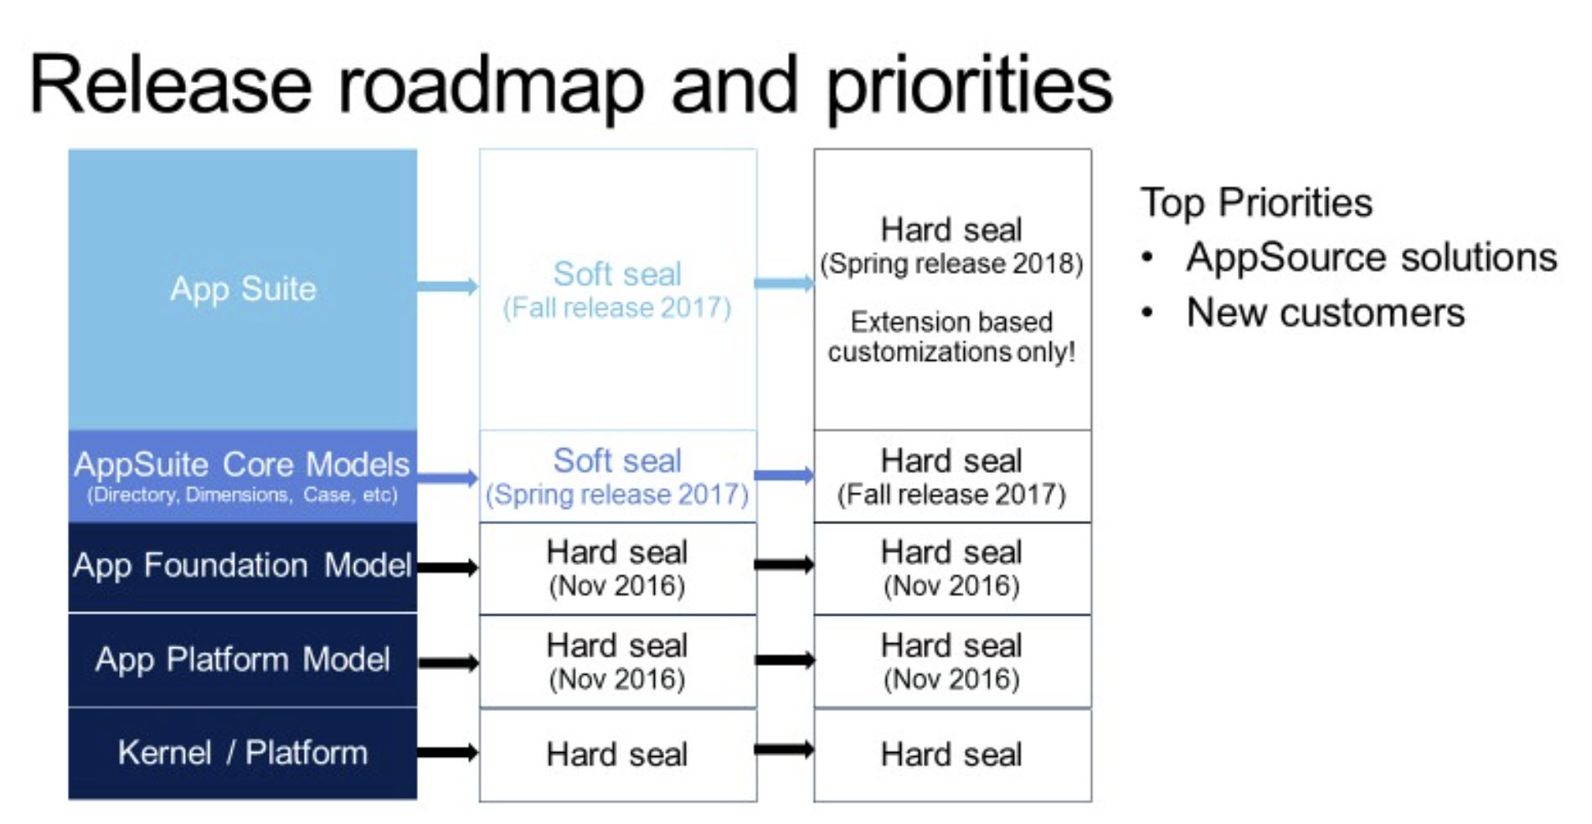
Development using extension’s approach
Models are sealed for over layering

Slide 26
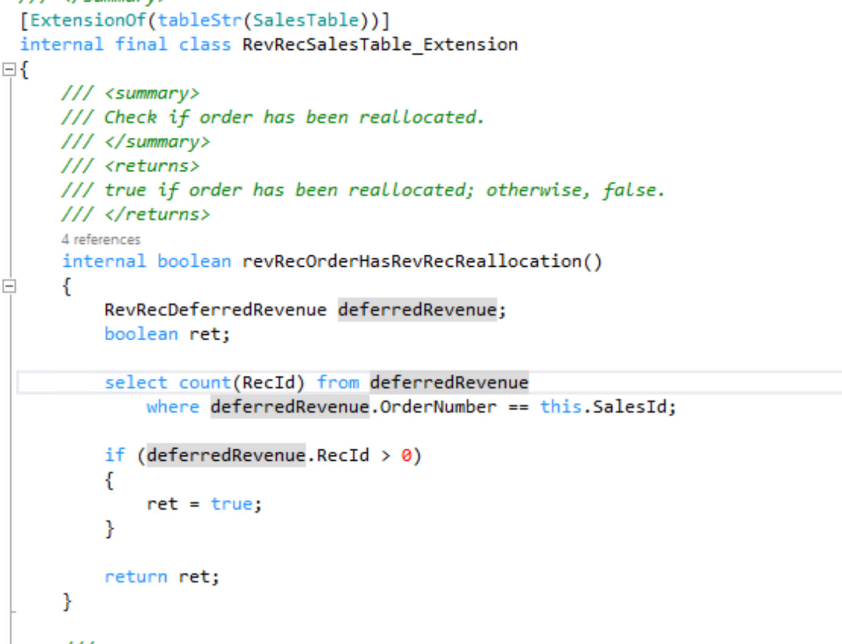
Development using extension’s approach
Code Extension Types
Events (Pre /Post)
Delegates
Chain of command(COC)
Widely used

Slide 27
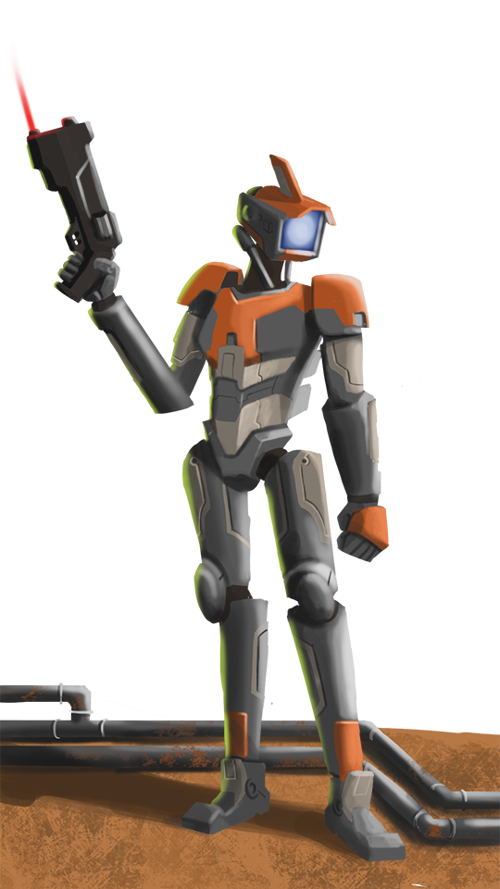
Development using extension’s approach
Chain Of command
You can wrap base public or protected methods
Access to protected members from extension classes

Slide 28
Development using extension’s approach
Extensibility Requests
Extensions is the only way to add on top of what comes with standard offering
Some customizations which are possible with over layering can not be accomplished using extensions
If you encounter a situation where extension is not possible, log extensibility request from LCS.

Slide 29
References
Analyze code upgrade
Configure code upgrade
Environment planning
Develop using extensions
Extensibility request

Slide 30
Upgrading Code

Slide 31

“Upgraded Code”
The LCS code upgrade tool will commit all the upgraded code into Azure DevOps
Code is overlayered and organized by underlying package
You have to sort through it and reorganize it based on the new extension rules

Slide 32

“Upgraded Code”
2 Basic Use Cases
New stuff
Removing overlayering
Ie; I created a new class MyGoodClass; move it to new package/model.
Ie; changed a method on CustTable; refactor/re-org that code for extension only

Slide 33
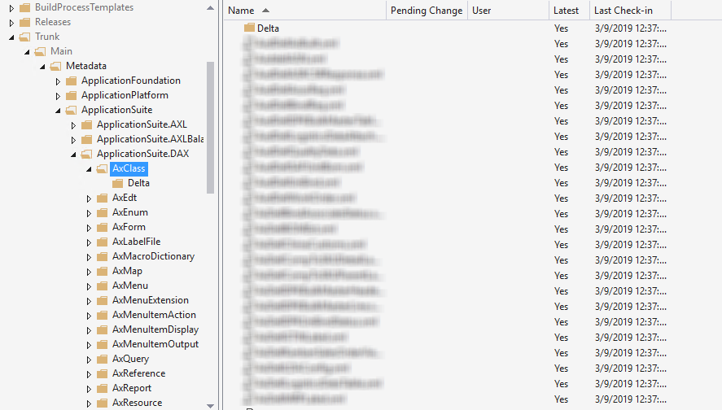
New Stuff

Slide 34
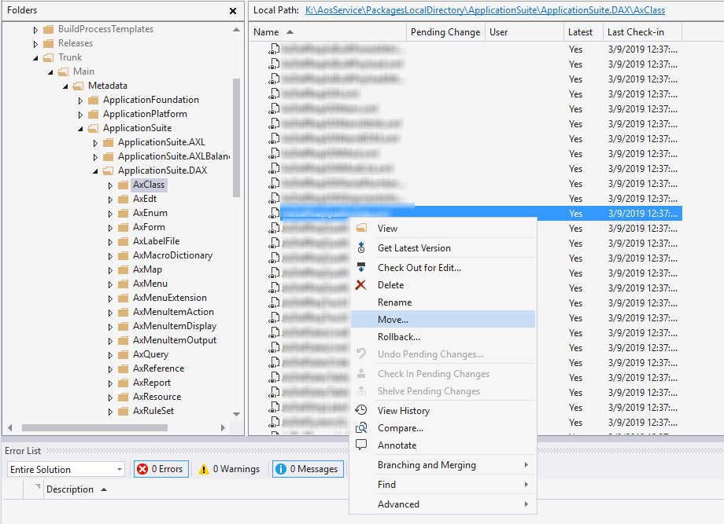
Move It

Slide 35
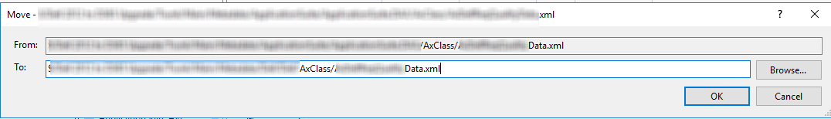
Really, that’s it.

Slide 36
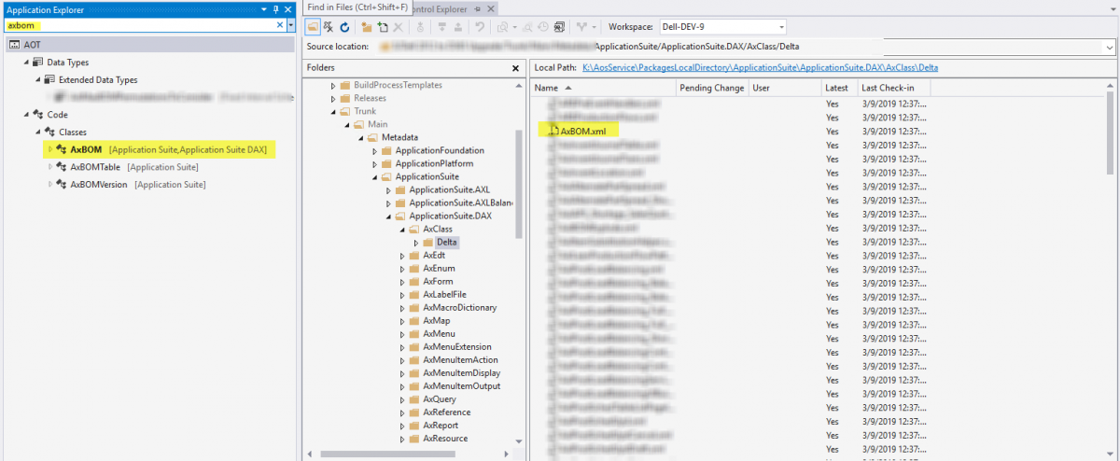
Overlayered Elements

Slide 37
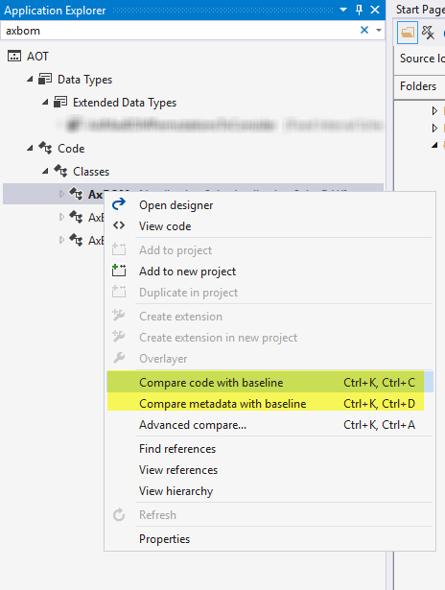
Comparing

Slide 38
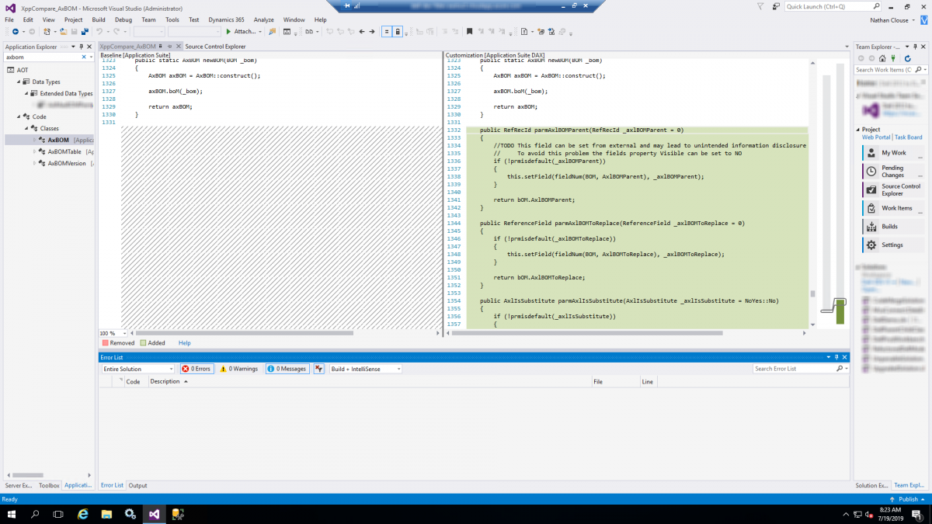
Compare code with baseline

Slide 39
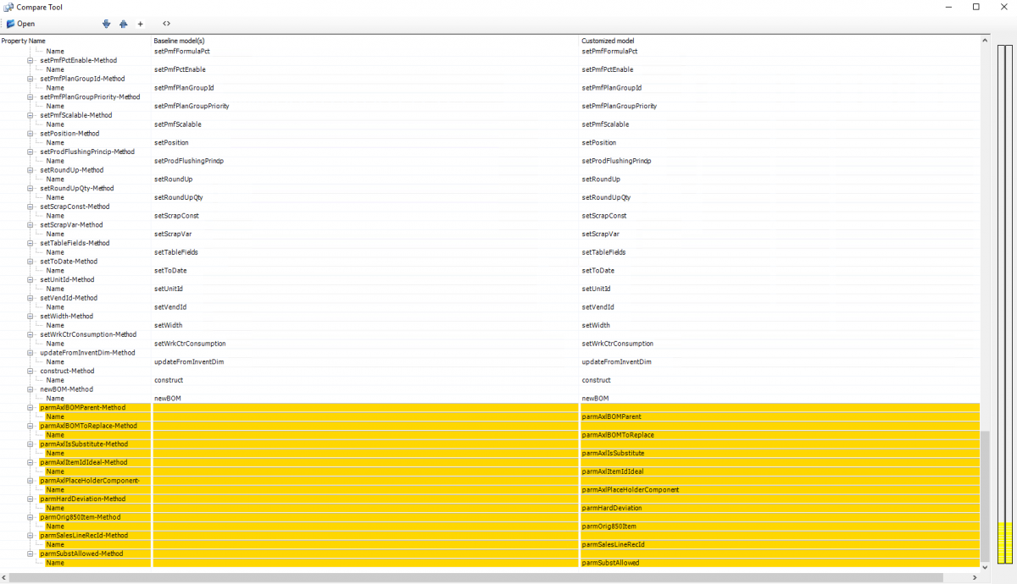
Compare metadata with baseline

Slide 40
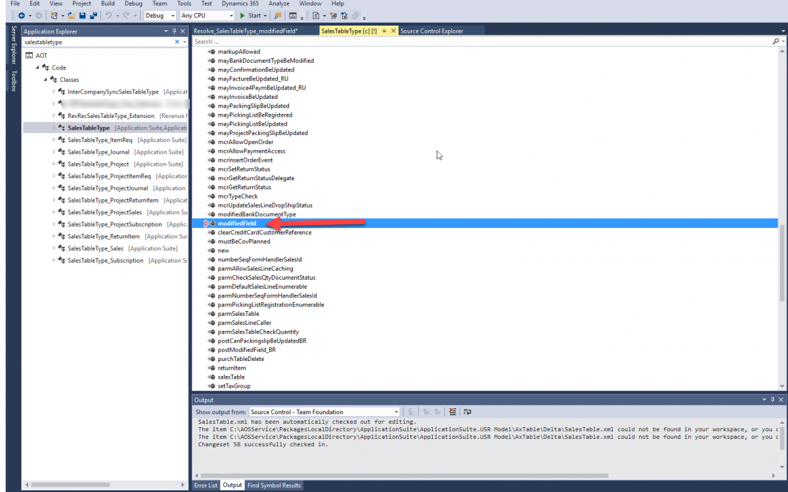
Other Feedback

Slide 42
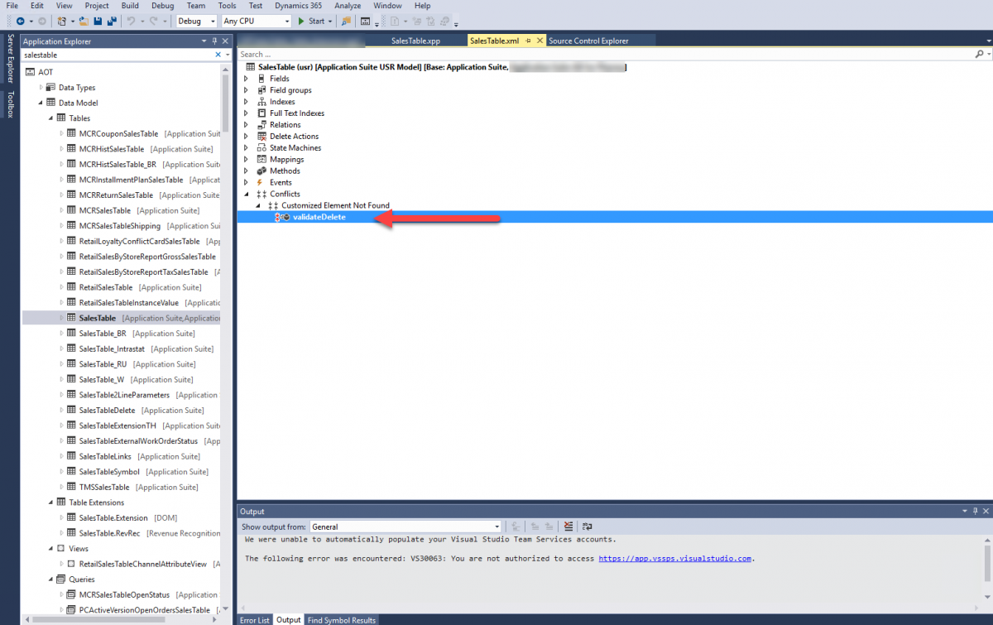
What if my code is on something not there anymore?

Slide 44
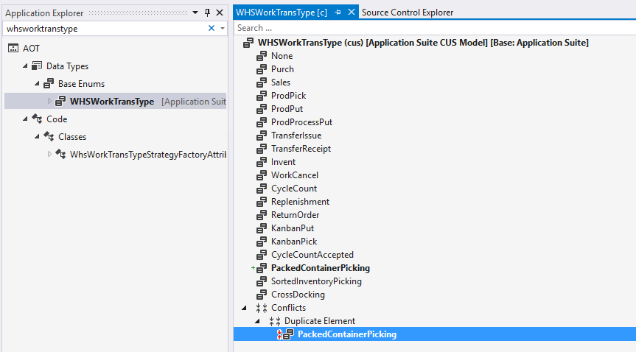
Prior Mistakes?

Slide 45
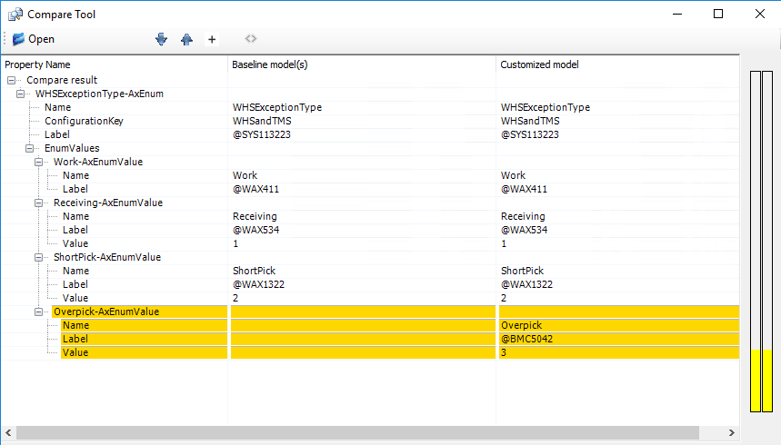
Enum Extensions

Slide 46

Overall Process
Make notes of what changed on the base element
Create an extension of the element
Remove the overlayered element
Open the extension and make the changes noted from the overlayered element

Slide 47
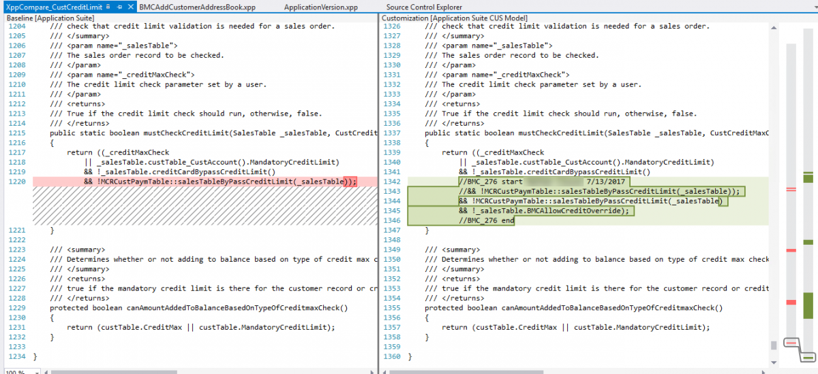
Example

Slide 48
Example
[ExtensionOf(classStr(CustCreditLimit))]
final class CustCreditLimitBMC_Extension
{
/// <summary>
/// BMC_276 start 7/13/2017
/// </summary>
/// <param name = "_salesTable"></param>
/// <param name = "_creditMaxCheck"></param>
/// <returns></returns>
public static boolean mustCheckCreditLimit(SalesTable _salesTable, CustCreditMaxCheck _creditMaxCheck)
{
//call base logic
boolean ret = next mustCheckCreditLimit(_salesTable, _creditMaxCheck);
//take that result and combine it with our additional condition
return (ret && !_salesTable.BMCAllowCreditOverride);
}
}

Slide 49

Let’s talk about jobs
The type of “Job” for an element is now gone
All jobs get upgraded into classes just so you have them
No AOT to open and run jobs now

Slide 50
Other Limitations
Not all properties are extensive
Not all things are extension
Not all things are available to extend
Data entities from 2012 not upgraded at all
Maps aren’t extensible either

Slide 51
Azure Dev Ops

Slide 52
Rundown
TFVC and Git available
TFVC officially supported
Git is what MSFT uses internally
Each control system has pros and cons
If you don’t know what Git is, use TFVC
Source control is mandatory

Slide 53
Rundown
Cloud Hosted Builds
Continuous integration
Gated Check-ins
Can include automated testing
Private Builds also an option with Azure or On Prem

Slide 54
Rundown
Package creation from build
Package deployment to LCS or Sandbox Environment
Azure Pipelines can orchestrate DB movements / refreshes as well
Tons of Automation Options

Slide 55
Integration opportunities and Power platform

Slide 56
Power Platform
Microsoft Power Platform provides a suite of capabilities for Dynamics 365 applications via the Power Platform admin center
Create Apps that do things with your data
Use related technologies like dual-write and virtual entities plus business events to stitch together data interaction workflows
Lots of possibilities for moving/replacing customizations in F&O (AX)

Slide 57
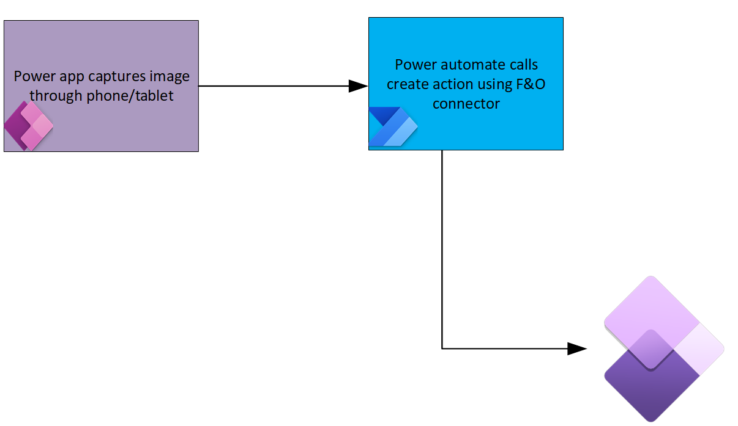
Example
Notes:
Attach document example

Slide 58
Questions?

Slide 59
Dynamics 365: Let’s talk Upgrade Rollout Approach (AX 2012 Upgrade Series: Part 6) – Tuesday @ 2:00
Dynamics 365 F&O Licensing, Upgrades, Costs and More (Part 2) – Tuesday @ 3:00
Retail and Warehousing: The Biggest Areas for Change in Dynamics 365 F&O (AX 2012 Upgrade Series: Part 3) – Wednesday @ 9:30
AX Sucks. Let’s talk Upgrades (AX 2012 Upgrade Series: Part 1)– Wednesday @ 10:30
An AX2012 Upgrade Journey - Wednesday @ 11:30
Dynamics 365 F&O Business Events From End to Start to End – Wednesday @ 1:40
Dynamics 365 F&O Upgrade Tech Talk: Code, Customizations, Extension and Power Platform (AX 2012 Upgrade Series: Part 5) – Thursday @ 10:00
How To Get The Most Out of Your Upgrade (AX 2012 Upgrade Series: Part 2) – Thursday @ 1:10

Slide 60
My Other Presentations
Dynamics 365 F&O Business Events From End to Start to End – Wednesday @ 1:40
Dynamics 365 F&O OData From Zero To Hero – Thursday @ 9:00
F&O Integration Roundup - Thursday @ 11:00
X++ Development Tips and Tricks plus D365FO.Tools! – Thursday @ 2:10

Slide 61
Give Away!

Slide 62

Please visit our booth
enVista booth #700
Meet with our experts
Learn about industry-leading practices
Get the most from your Microsoft investments
Register to win a YETI™ cooler
enVista
Booth
Hall C Entry

Slide 63
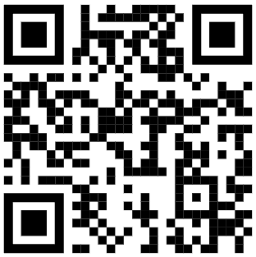
Survey Code

